Slide 1
E系列低压锂电2-3.8T，4-5T平衡重式叉车液压系统培训
Training on hydraulic system of E-series low-voltage lithium battery 2-3.8T，4-5T Counterbalanced Forklift
编制：戴婷
Prepared by: Ting Dai
单位：柳工叉车工业车辆研究院
Unit: LiuGong forklift industrial
vehicle research institute

Slide 2
一、液压传动系统概述
Overview of Hydraulic Transmission System
二、整机液压系统
Complete hydraulic system
三、工作液压系统
Working hydraulic system
四、转向液压系统
Steering hydraulic system
五、门架液压系统
Mast hydraulic system
六、常见故障诊断及处理方法
Common fault diagnosis and handling methods

Slide 3
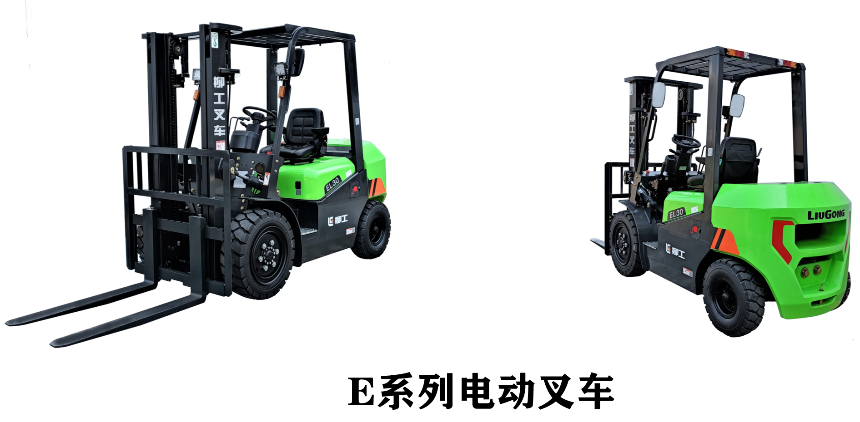
一、液压传动系统概述Overview of Hydraulic Transmission System
液压传动系统 Hydraulic Transmission System
优点 Advantage
结构紧凑、管路便于布置、运动平稳、控制方便等
Compact structure, easy pipeline layout, smooth movement, convenient control, etc
组成 Compose
液压动力元件：将原动机（电机或发动机）的机械能转化为液压油的压力能；平衡重式叉车多用齿轮泵。
Hydraulic power components: convert the mechanical energy of the prime mover (motor or engine) into the pressure energy of hydraulic oil; Balanced forklifts often use gear pumps.
液压执行元件：将液压泵提供的液压能转换为机械能；平衡重式叉车用油缸；如起升油缸、倾斜油缸、转向油缸等。
Hydraulic actuators: convert hydraulic energy provided by hydraulic pumps into mechanical energy; Oil cylinder for balanced forklift; Such as lifting cylinders, tilting cylinders, steering cylinders, etc.
液压控制元件：对工作介质的压力、流量和流动方向
进行调节控制的装置；平衡重式叉车用多路换向阀。
Hydraulic control components: devices that regulate and control
the pressure, flow rate, and flow direction of working media;
Multi directional valve for balanced forklift.
液压辅助元件：为保证液压系统正常工作所需的上述
三类元件之外的装置；如液压油箱、管路、过滤器等。
Hydraulic auxiliary components: devices other than the above three
types of components required to ensure the normal operation of
the hydraulic system; Such as hydraulic oil tanks, pipelines, filters, etc.
工作介质：液压系统中进行能量和信号传递的液体；
一般为抗磨液压油（常用规格：L-HM32）。
Working medium: Liquid used for energy and signal transmission in hydraulic systems;
Generally, it is anti-wear hydraulic oil (commonly used specification: L-HM32).
E series electric fork lift truck

Slide 4
二、整机液压系统介绍Complete hydraulic system
2.1、E系列低压锂电整机液压系统
E-Series Low Voltage Lithium Battery Hydraulic System
HYDRAULIC SCHEMATIC
整机液压系统
Complete hydraulic system
门架液压系统
Mast hydraulic system
转向液压系统
Steering hydraulic system
工作液压系统
Working hydraulic system

Slide 5
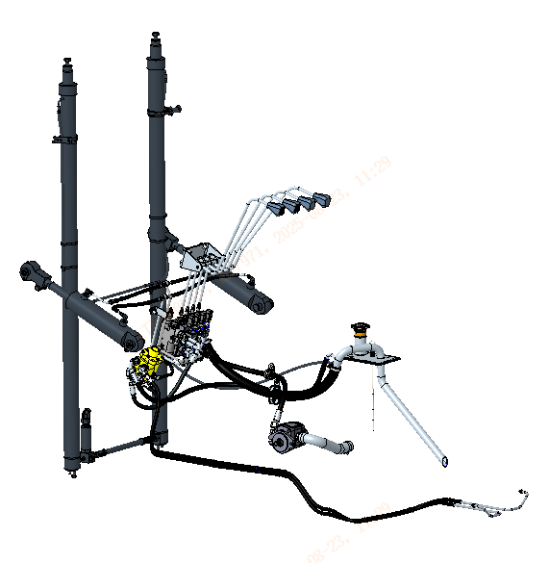
二、整机液压系统介绍Complete hydraulic system
2.2、整机布局（E系列2.0-3.8t机型）
Whole machine layout (E series 2.0-3.8t models)
Mast hydraulic system
Working hydraulic system
Steering hydraulic system

Slide 6
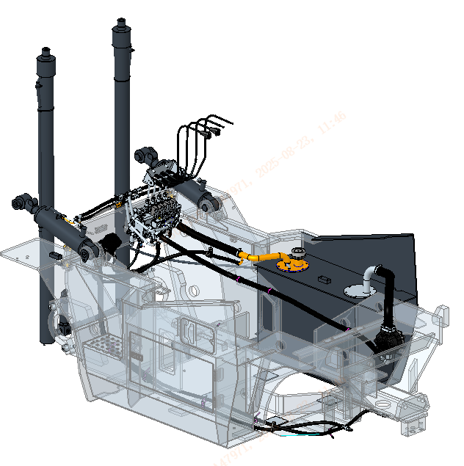
二、整机液压系统介绍Complete hydraulic system
2.2、整机布局（E系列4.0-5.0t机型）
Whole machine layout (E series 4.0-5.0t models)
Mast hydraulic system
Working hydraulic system
Steering hydraulic system

Slide 7
二、整机液压系统介绍Complete hydraulic system
2.3、元件介绍
Hydraulic components |  | Parameter |  |  |  |  |  |  | Remarks
 | 2.0-2.5T | 3.0T | 3.5T | 3.8T | 4.0T | 4.5T | 5.0LT | 5.0T
齿轮泵 PUMP | 23mL/r | 23mL/r |  | 25mL/r | 45mL/r |  |  |  | Used to provide high-pressure oil to hydraulic systems
多路换向阀 Multi way directional valve | Pressure 18MPa Flow rate 75L/min |  | Pressure 20.5MPa Flow rate 75L/min |  | Pressure 19.5MPa Flow rate 160L/min |  |  |  | The manual control valve and distribution valve have four working pairs, which are used to control the direction and speed of movement of each oil cylinder
转向器 Steering gear | Sept volume 100mL/r |  |  |  | Sept volume 200mL/r |  |  |  | Used to control the movement of the rear axle steering cylinder and achieve vehicle steering operation
起升油缸Lifting cylinder | φ50×φ40×1495 | φ56×φ45×1495 |  | φ60×φ45×1495 | Cylinder diameter, rod diameter, stroke φ70×φ50×1495 |  |  |  | Support the lifting movement of the entire fork
倾斜油缸 Tilt cylinder | φ70×φ32×168 | φ70×φ32×168 | φ80×φ35×168 |  | Cylinder diameter, rod diameter, stroke φ90×φ45×202.5 |  |  |  | Support the forward and backward tilting motion of the entire fork
限速阀Speed-limiting valve | Flow rate 60L/min | Flow rate 75L/min |  |  | Flow rate 121L/min |  |  |  | Used to control the movement of the rear axle steering cylinder and achieve vehicle steering operation

Slide 8
三、工作液压系统Working hydraulic system
3.1、工作液压系统原理Working hydraulic system principle
1、车辆启动分配阀电磁铁不通电；
Vehicle start distribution valve solenoid not powered;
2、当工作液压系统无任何动作时，即分配阀中的起升、倾斜、调距联均处于中位，所有油液通过主阀油道直接回油箱，此时液压系统保持在低压小于0.5MPa的工作压力下运行。
When there is no action in the working hydraulic system, that is, the lifting, tilting, and distance adjustment links in the distribution valve are all in the neutral position, and all oil is directly returned to the oil tank through the main valve oil passage. At this time, the hydraulic system operates at a working pressure of less than 0.5 MPa.
3、通过操纵手柄控制控制货叉升降、货叉前后倾等时，使油液可以根据需求流动到所需要联的执行元件上。
By manipulating the joystick to control the lifting and tilting of the fork, the oil can flow to the required actuators according to demand.
4、分配阀具有OPS功能及中位检测开关，当结合控制器程序，实现当驾驶员未坐到座椅上或未系安全带时操作货叉无动作，操作杆不在中位的情况下坐到座椅上并系上安全带，货叉同样无法动作，即需要坐上座椅同时系好安全带后操作杆在中位，OPS功能限制才能解除，起到安全保护作用。
The distribution valve has OPS function and a center position detection switch. When combined with the controller program, it realizes that when the driver is not sitting on the seat or not fastening the seat belt, the fork does not move and the operating lever is not in the center position, the fork cannot move when sitting on the seat and fastening the seat belt. Therefore, the OPS function restriction can only be lifted when the operating lever is in the center position after sitting on the seat and fastening the seat belt, providing safety protection.
Multi-way valve
Pump

Slide 9
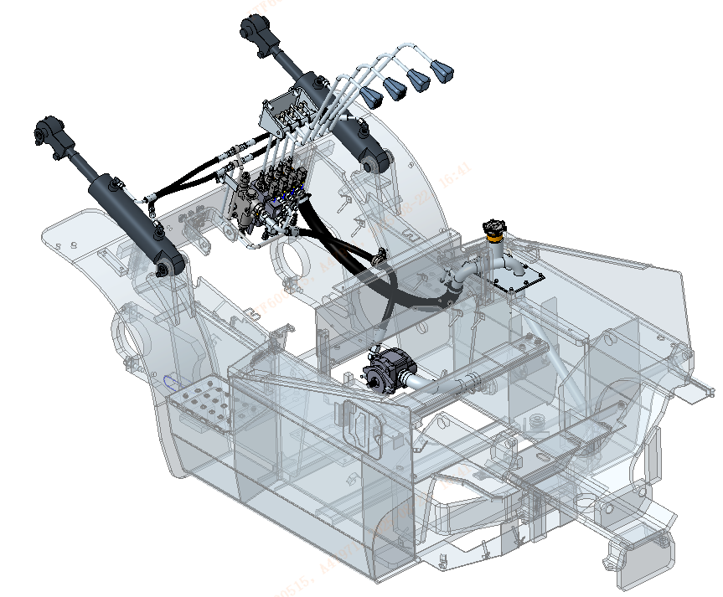
三、工作液压系统Working hydraulic system
3.2、工作液压系统布局（E系列2.0-3.8t机型）
Layout of Working Hydraulic System (E Series 2.0-3.8t Models)
Multi-way valve
Tilt cylinder
Pump

Slide 10
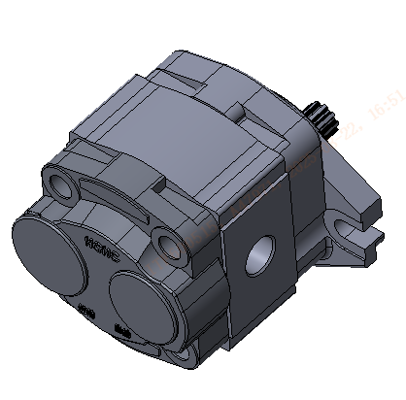
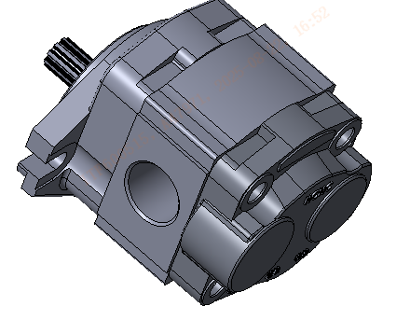
三、工作液压系统Working hydraulic system
3.3.1、齿轮泵（E系列2.0-3.8t机型） Pump (E Series 2.0-3.8t Models)
工作泵位于车架靠右侧中间底部连接板，通过螺栓与泵电机连接；由泵电机驱动，为工作液压系统提供油液。
The working pump is located at the bottom connecting plate on the right side of the frame, and is connected to the pump motor through bolts; Driven by a pump motor, it provides oil for the working hydraulic system.
工作泵外形图下图：
The outline diagram of the working pump is shown below:
Inlet
Oil outlet
Item | Parameter | Item | Parameter | Item | Parameter
Rated pressure | 20MPa | Maximum pressure | 25MPa | Rated speed | 2500rpm
Volume | 23/25mL/r | Direction of rotation | right-handed | Fluid medium | L-HM32#

Slide 11
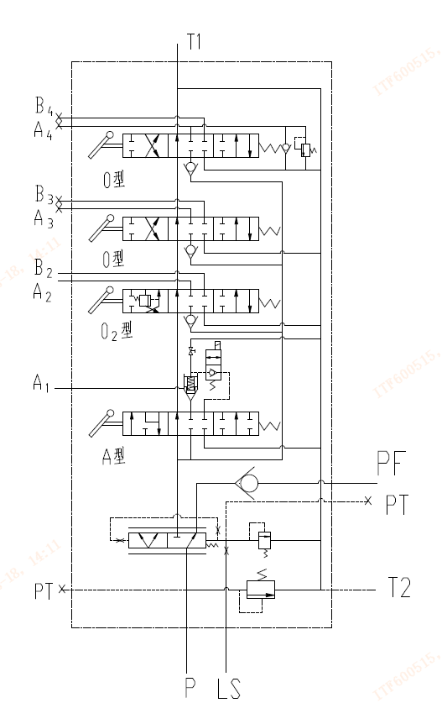
三、工作液压系统Working hydraulic system
3.3.2、多路换向阀（E系列2.0-3.8t机型）
Multi-way directional control valve (E Series 2.0-3.8t model)
多路阀安装在车架前端的车架连接板。分配阀的作用是通过改变油液的流动方向和通流截面积，控制各油缸的运动方向和速度，以满足叉车对不同工况的作业要求。
The multi-way valve is installed on the frame connection plate at the front end of the frame. The function of the distribution valve is to control the movement direction and speed of each cylinder by changing the flow direction and cross-sectional area of the oil, so as to meet the operation requirements of forklifts under different working conditions.
结构形式：片式四联开中位滑阀式；
Structural form: Four piece open center slide valve type;
元件组成：阀体、换向阀芯、过载阀、优先阀芯、电磁换向阀、锥阀等部分组成；
Component composition: It consists of valve body, directional control valve core, overload valve, priority valve core, electromagnetic directional control valve, cone valve and other parts.
货叉升降联换向阀：三位六通阀，它可控制货叉的起升和下降两个动作；
Fork lift coupling directional control valve: A three-position six-way valve, which can control the lifting and lowering actions of the fork.
货叉前后倾联换向阀：三位六通阀，它可控制货叉的前后倾斜两个动作；
Fork forward and backward tilting directional control valve: A three-position six-way valve, which can control two actions of the fork's forward and backward tilting.
8
9
7
6
5
4
2
3
1
1、主溢流阀Main relief valve 2、优先分流阀Priority diversion valve 3、转向溢流阀Directional relief valve
4、起升联换向阀 Lifting coupling directional control valve 5、电磁换向阀+锥阀 Electromagnetic directional control valve + cone valve
6、前后倾换向阀Forward and backward tilting directional control valve 7、8、属具换向阀 Attachment directional control valve 9、属具过载阀 Accessory overload valve

Slide 12
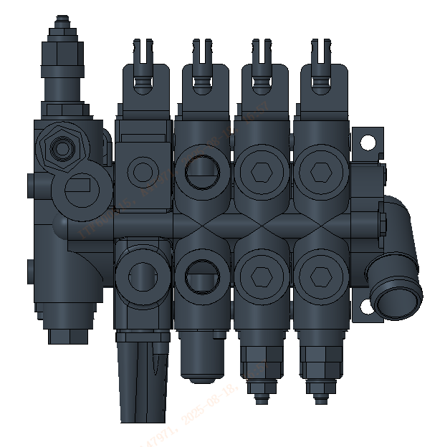
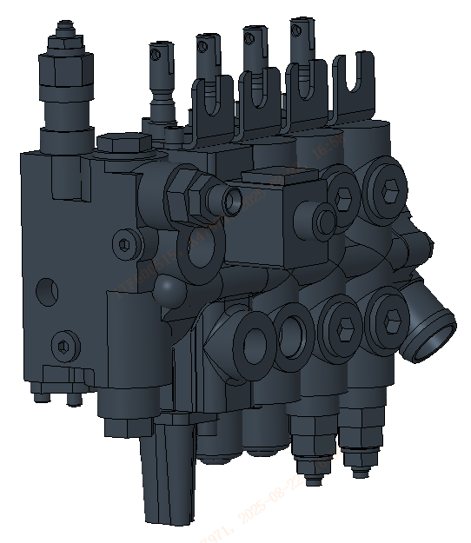
三、工作液压系统Working hydraulic system
3.3.2、多路换向阀（E系列2.0-3.8t机型）Multi-way directional control valve (E Series 2.0-3.8t model)
Main relief valve
Oil Port Diagram
B2
B3
B4
PF
P
LS
Directional relief valve
A1
B2
B3
B4
Descending solenoid valve

Slide 13
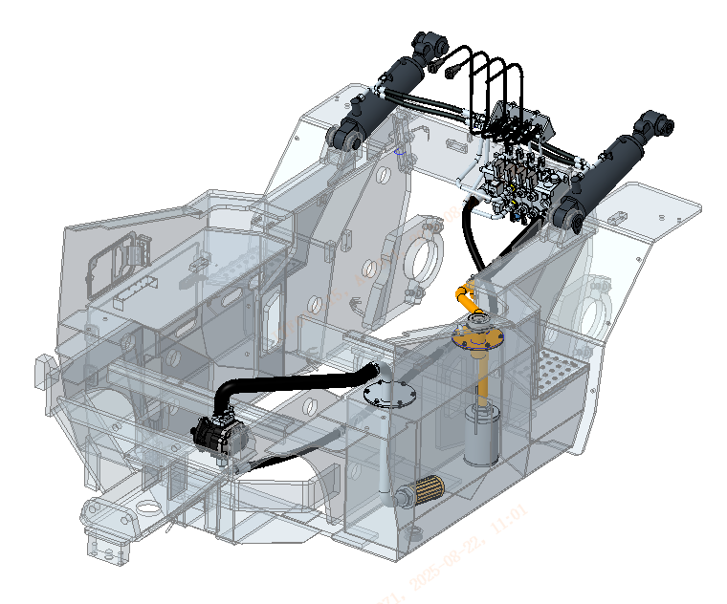
三、工作液压系统Working hydraulic system
3.2、工作液压系统布局（E系列4.0-5.0t机型）
Layout of Working Hydraulic System (E Series 4.0-5.0t Models)
Multi-way valve
Tilt cylinder
Pump

Slide 14
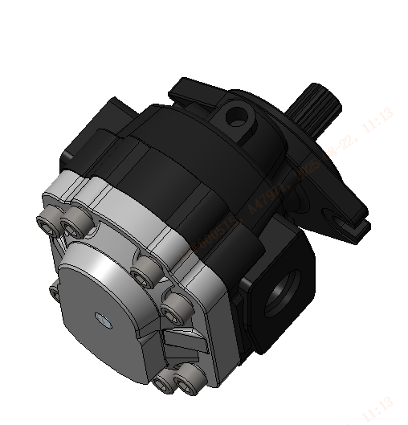
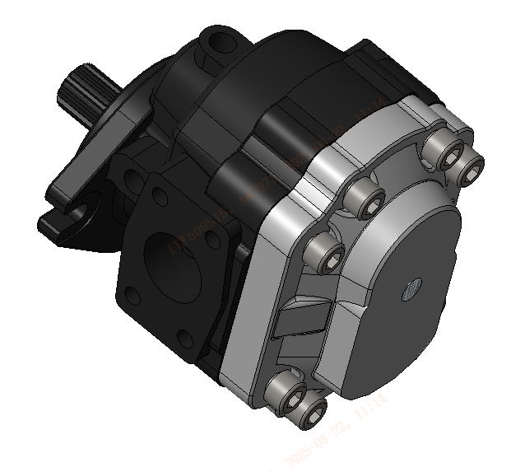
三、工作液压系统Working hydraulic system
3.3.1、齿轮泵（E系列4.0-5.0t机型）Pump (E Series 4.0-5.0t Models)
工作泵位于车架尾部尾架上方，通过螺栓与泵电机连接；由泵电机驱动，为工作液压系统提供油液。
The working pump is located above the tailframe at the rear of the vehicle frame and is connected to the pump motor through bolts. Driven by the pump motor, it supplies oil to the working hydraulic system.
工作泵外形图下图：
The outline diagram of the working pump is shown below:
Oil outlet
Inlet
Item | Parameter | Item | Parameter | Item | Parameter
Rated pressure | 20MPa | Maximum pressure | 25MPa | Rated speed | 2500rpm
Volume | 45mL/r | Direction of rotation | right-handed | Fluid medium | L-HM32#

Slide 15
三、工作液压系统Working hydraulic system
3.3.2、多路换向阀（E系列4.0-5.0t机型）Multi-way directional control valve (E Series 4.0-5.0t model)
多路阀安装在车架前端的车架连接板。分配阀的作用是通过改变油液的流动方向和通流截面积，控制各油缸的运动方向和速度，以满足叉车对不同工况的作业要求；该负载敏感阀通过增加卸荷阀，在门架不同操作时压力反馈至卸荷阀芯两端，卸荷阀芯弹簧力一定，压差固定，实现良好的操纵性，系统流量与负载无关。
The multi-way valve is installed on the frame connection plate at the front end of the frame. The function of the distribution valve is to control the movement direction and speed of each cylinder by changing the flow direction and cross-sectional area of the oil, so as to meet the operation requirements of forklifts under different working conditions. This load-sensitive valve achieves good maneuverability by adding an unloading valve. When the mast operates at different times, the pressure is fed back to both ends of the unloading valve core. The spring force of the unloading valve core remains constant, and the pressure difference is fixed. The system flow is independent of the load.
结构形式：片式四联开中位滑阀式；
Structural form: Four piece open center slide valve type;
元件组成：阀体、换向阀芯、过载阀、优先阀芯、电磁切换阀、锥阀等部份组成；
Component composition: It consists of valve body, directional control valve core, overload valve, priority valve core, electromagnetic directional control valve, cone valve and other parts.
货叉升降联换向阀：三位七通阀，它可控制货叉的起升和下降两个动作；
Fork lift coupling directional control valve: A three-position seven-way valve, which can control the lifting and lowering actions of the fork.
货叉前后倾联换向阀：三位七通阀，它可控制货叉的前后倾斜两个动作；
Fork forward and backward tilting directional control valve: A three-position seven-way valve, which can control two actions of the fork's forward and backward tilting.

Slide 16
三、工作液压系统Working hydraulic system
3.3.2、多路换向阀（E系列4.0-5.0t机型）Multi-way directional control valve (E Series 4.0-5.0t model)
5
7
11
9
13
1
10
2
4
6
14
3
8
12
1、转向溢流阀Directional relief valve 2、优先分流阀Priority diversion valve 3、起升联换向阀Lifting coupling directional control valve
4、电磁换向阀Electromagnetic directional control valve 5、锥阀 Cone valve 6、前后倾换向阀Forward and backward tilting directional control valve
7、平衡阀Balance valve 8、梭阀 Shuttle valve 9、11、属具换向阀Attachment directional control valve 10、12、属具过载阀Accessory overload valve
13、三位两通换向阀（卸荷阀）Three-position two-way directional control valve (unloading valve) 14、主溢流阀 Main relief valve

Slide 17
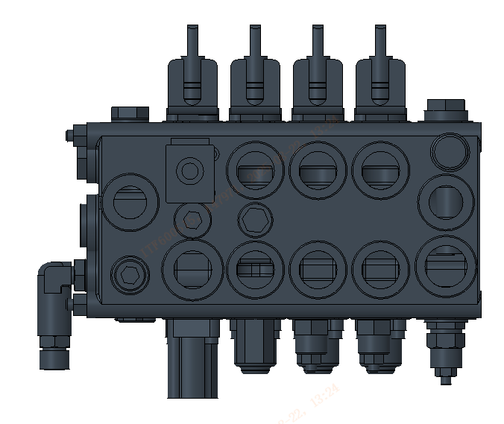
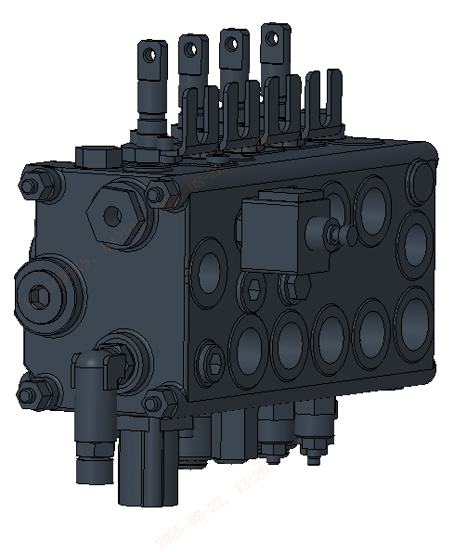
三、工作液压系统Working hydraulic system
3.3.2、多路换向阀（E系列4.0-5.0t机型）Multi-way directional control valve (E Series 4.0-5.0t model)
Oil Port Diagram
B2
B3
Directional relief valve
B4
LS
P2
P1
T
Descending solenoid valve
PF
Main relief valve
A1
B2
balance valve
B3
B4
Three or four-way overload valve

Slide 18
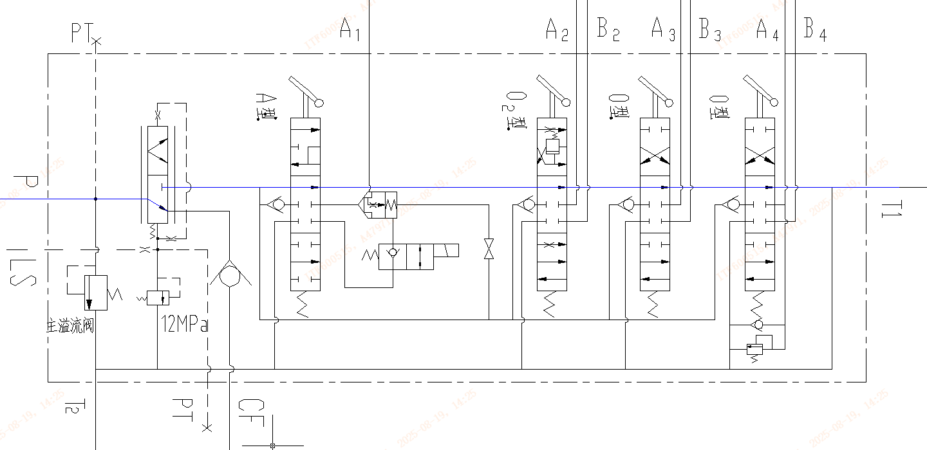
三、工作液压系统Working hydraulic system
3.3.2、多路换向阀（E系列2.0-3.8t机型）Multi-way directional control valve (E Series 2.0-3.8t model)
1.分配阀中位：
当分配阀中位时，齿轮泵供油给转向油路，其余全部油液直接回油箱，系统属于低压卸荷状态。
Middle position of the distribution valve：
When the distribution valve is in the neutral position, the gear pump supplies oil to the steering oil circuit, and all the remaining oil is directly returned to the oil tank. The system is in a low-pressure unloading state.
高压油
high-pressure oil
回油
Oil return

Slide 19
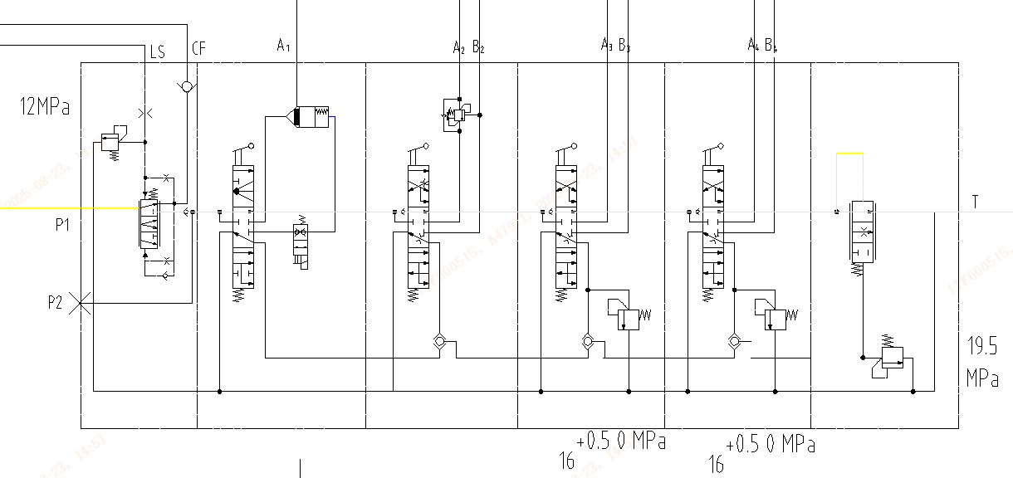
三、工作液压系统Working hydraulic system
3.3.2、多路换向阀（E系列4.0-5.0t机型）Multi-way directional control valve (E Series 4.0-5.0t model)
1.分配阀中位：
当分配阀中位时，齿轮泵供油给转向油路，其余全部油液通过卸荷阀芯直接回油箱，系统属于低压卸荷状态。
Middle position of the distribution valve：
When the distribution valve is in the neutral position, the gear pump supplies oil to the steering oil circuit, and all the remaining oil is directly returned to the oil tank through the unloading valve core. The system is in a low-pressure unloading state.
高压油
high-pressure oil
回油
Oil return
控制油
control oil

Slide 20
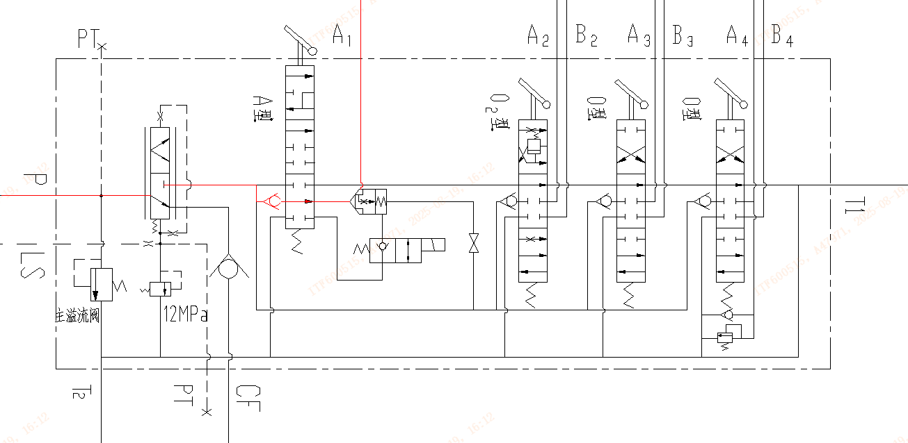
三、工作液压系统Working hydraulic system
3.3.2、多路换向阀（E系列2.0-3.8t机型）Multi-way directional control valve (E Series 2.0-3.8t model)
2.货叉起升位：
操纵操纵杆使主阀位于起升位时主阀内油液的流动方向：工作泵供油至起升油缸
Fork lift position:
When operating the control lever to position the main valve in the lifting position, the flow direction of the oil in the main valve: The working pump supplies oil to the lifting cylinder
A1连接起升油缸大腔
A1 connects the large cavity of the lifting cylinder
高压油
high-pressure oil
回油
Oil return

Slide 21
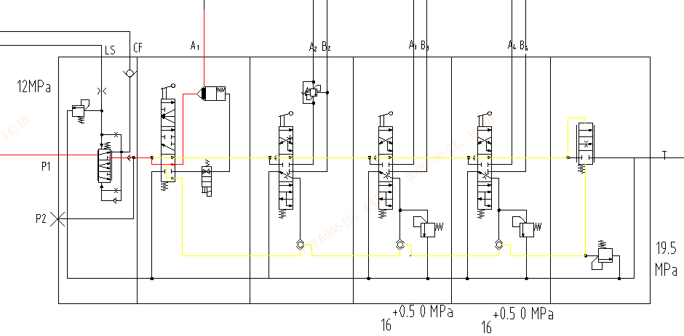
三、工作液压系统Working hydraulic system
3.3.2、多路换向阀（E系列4.0-5.0t机型）Multi-way directional control valve (E Series 4.0-5.0t model)
2.货叉起升位：
操纵操纵杆使主阀位于起升位时主阀内油液的流动方向：工作泵供油至起升油缸，卸荷阀芯在弹簧力作用下不工作。
Fork lift position:
When operating the control lever to position the main valve in the lifting position, the flow direction of the oil in the main valve: The working pump supplies oil to the lifting cylinder, and the unloading valve core does not work under the action of the spring force.
A1连接起升油缸大腔
A1 connects the large cavity of the lifting cylinder
高压油
high-pressure oil
回油
Oil return
控制油
control oil

Slide 22
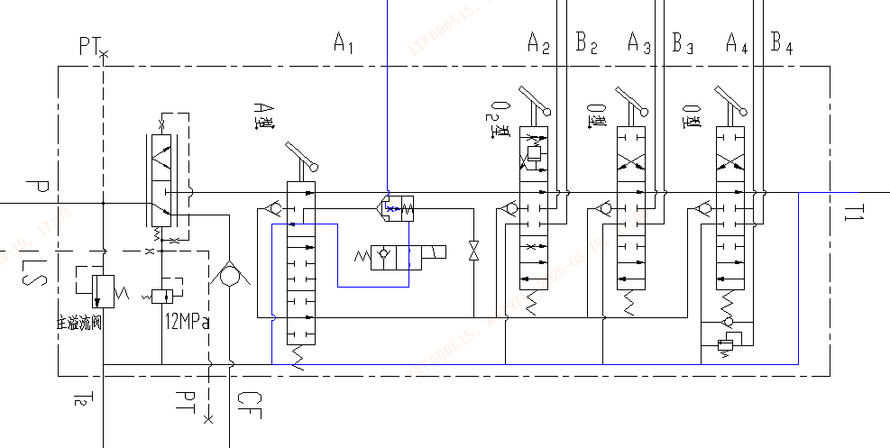
三、工作液压系统Working hydraulic system
3.3.2、多路换向阀（E系列2.0-3.8t机型）Multi-way directional control valve (E Series 2.0-3.8t model)
3.货叉下降位：
操纵操纵杆使主阀位于下降位时主阀内油液的流动方向：工作泵无需供油，起升油缸内的油液通过自重作用回油箱。
Fork lift position:
When operating the control lever to position the main valve in the lifting position, the flow direction of the oil in the main valve: The working pump supplies oil to the lifting cylinder, and the unloading valve core does not work under the action of the spring force.
高压油
high-pressure oil
回油
Oil return

Slide 23
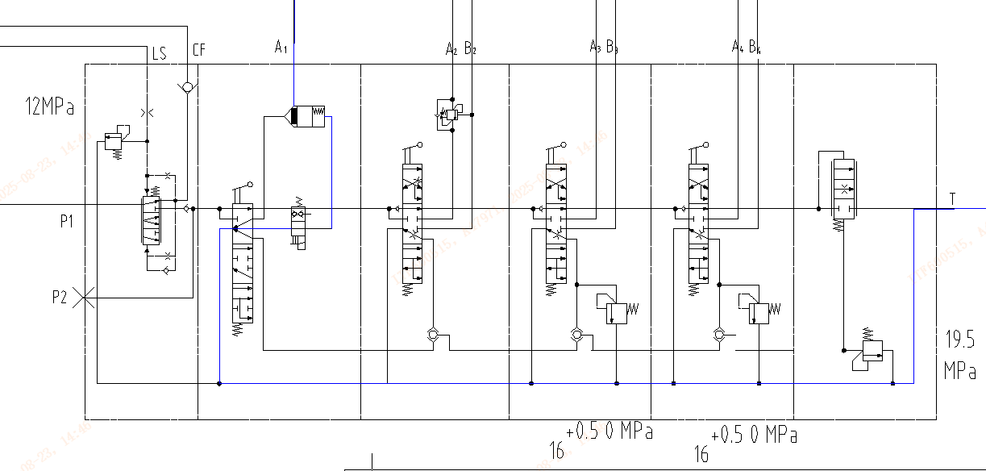
三、工作液压系统Working hydraulic system
3.3.2、多路换向阀（E系列4.0-5.0t机型）Multi-way directional control valve (E Series 4.0-5.0t model)
3.货叉下降位：
操纵操纵杆使主阀位于下降位时主阀内油液的流动方向：工作泵无需供油，起升油缸内的油液通过自重作用回油箱。
Fork descent position
When the control lever is operated to position the main valve in the descending position, the flow direction of the oil in the main valve: The working pump does not need to supply oil, and the oil in the lifting cylinder returns to the oil tank through its own weight.
高压油
high-pressure oil
回油
Oil return
控制油
control oil

Slide 24
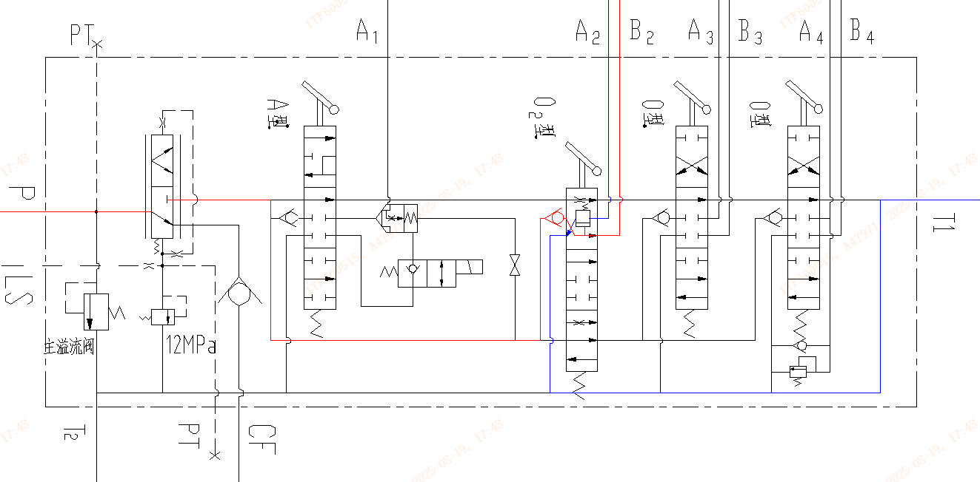
三、工作液压系统Working hydraulic system
3.3.2、多路换向阀（E系列2.0-3.8t机型）Multi-way directional control valve (E Series 2.0-3.8t model)
4.货叉前倾位：
操纵操纵杆使主阀位于前倾位时主阀内油液的流动方向：工作泵给倾斜油缸大腔供油，小腔油液经过平衡阀后流回油箱;换向阀内置平衡阀，防止货叉前倾时，因货物的重量前倾速度过快，起安全保护作用。
Fork forward tilt position
When the control lever is operated to position the main valve in the forward tilt position, the flow direction of the oil in the main valve: The working pump supplies oil to the large chamber of the tilting cylinder, and the oil in the small chamber flows back to the oil tank after passing through the balance valve. The reversing valve is equipped with a built-in balance valve to prevent the forks from tilting forward too quickly due to the weight of the goods, playing a safety protection role.
A2至倾斜油缸小腔
A2 to the small cavity of the inclined cylinder
B2至倾斜油缸大腔
B2 to the large cavity of the inclined cylinde
高压油
high-pressure oil
回油
Oil return

Slide 25
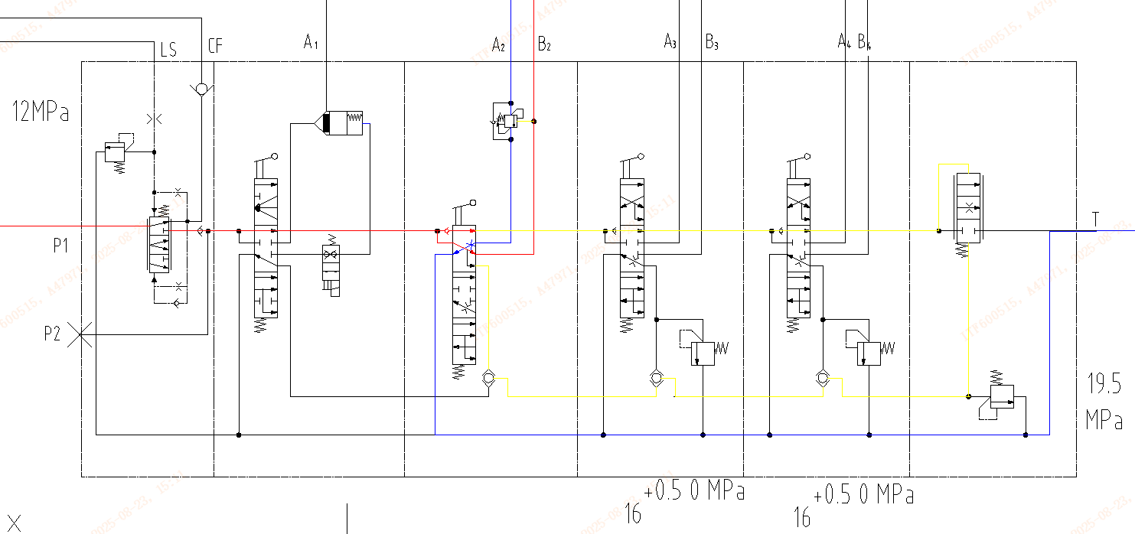
三、工作液压系统Working hydraulic system
3.3.2、多路换向阀（E系列4.0-5.0t机型）Multi-way directional control valve (E Series 4.0-5.0t model)
4.货叉前倾位：
操纵操纵杆使主阀位于前倾位时主阀内油液的流动方向：工作泵给倾斜油缸大腔供油，小腔油液经过平衡阀后流回油箱;换向阀内置平衡阀，防止货叉前倾时，因货物的重量前倾速度过快，起安全保护作用。
Fork forward tilt position
When the control lever is operated to position the main valve in the forward tilt position, the flow direction of the oil in the main valve: The working pump supplies oil to the large chamber of the inclined cylinder, and the oil in the small chamber flows back to the oil tank after passing through the balance valve. The directional control valve is equipped with a built-in balance valve to prevent the forks from tilting forward too quickly due to the weight of the goods, providing safety protection.
A2至倾斜油缸小腔
A2 to the small cavity of the inclined cylinder
B2至倾斜油缸大腔
B2 to the large cavity of the inclined cylinde
高压油
high-pressure oil
回油
Oil return
控制油
control oil

Slide 26
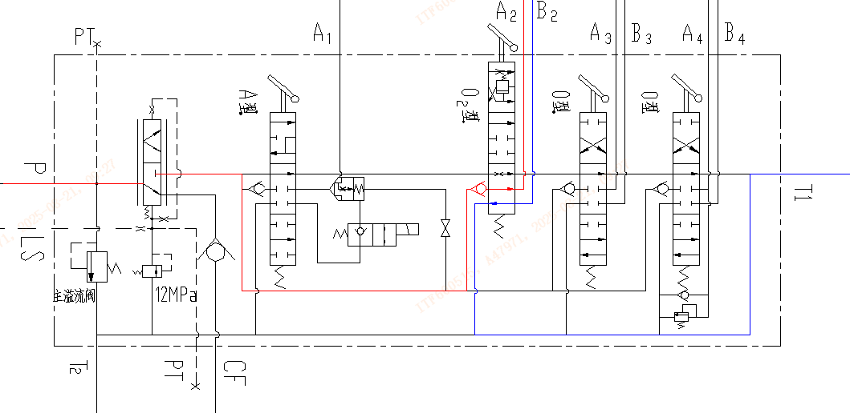
三、工作液压系统Working hydraulic system
3.3.2、多路换向阀（E系列2.0-3.8t机型）Multi-way directional control valve (E Series 2.0-3.8t model)
5.货叉后倾位：
操纵操纵杆使主阀位于后倾位时主阀内油液的流动方向：工作泵给倾斜油缸小腔供油，油缸大腔油液经过换向阀回流到油箱。
Fork rearward tilt:
When the control lever is operated to position the main valve in the backward tilting position, the flow direction of the oil in the main valve: The working pump supplies oil to the small chamber of the tilting cylinder, and the oil in the large chamber of the cylinder flows back to the oil tank through the reversing valve.
高压油
high-pressure oil
回油
Oil return

Slide 27
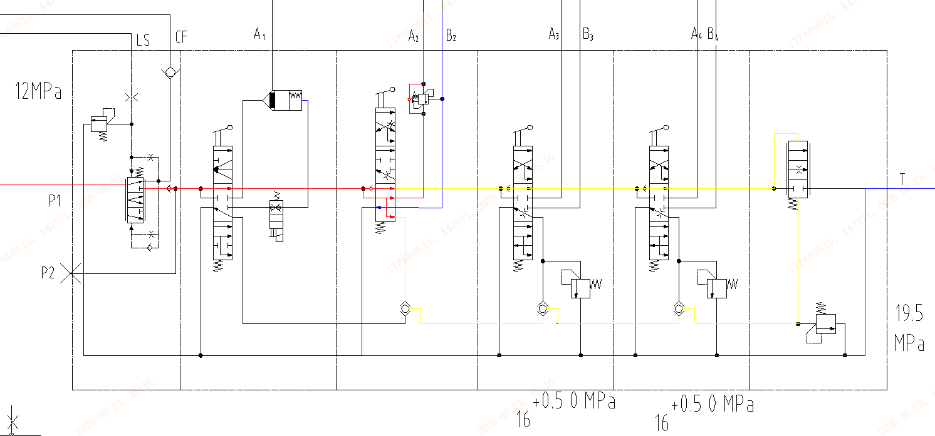
三、工作液压系统Working hydraulic system
3.3.2、多路换向阀（E系列4.0-5.0t机型）Multi-way directional control valve (E Series 4.0-5.0t model)
5.货叉后倾位：
操纵操纵杆使主阀位于后倾位时主阀内油液的流动方向：工作泵给倾斜油缸小腔供油，油缸大腔油液经过换向阀回流到油箱。
Fork rearward tilt:
When the control lever is operated to position the main valve in the backward tilting position, the flow direction of the oil in the main valve: The working pump supplies oil to the small chamber of the tilting cylinder, and the oil in the large chamber of the cylinder flows back to the oil tank through the reversing valve.
高压油
high-pressure oil
回油
Oil return
控制油
control oil

Slide 28
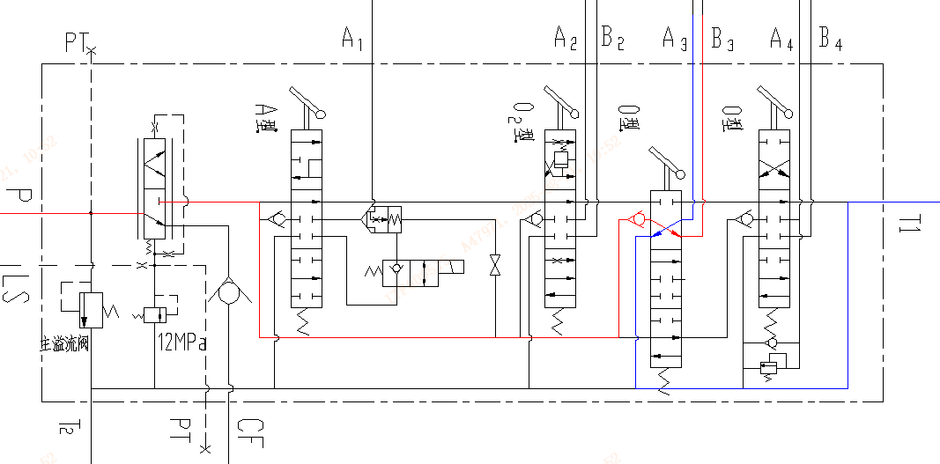
三、工作液压系统Working hydraulic system
3.3.2、多路换向阀（E系列2.0-3.8t机型）Multi-way directional control valve (E Series 2.0-3.8t model)
6.属具油缸移位（如,侧移器）：
操纵操纵杆使主阀位于左移动位时主阀内油液的流动方向：工作泵给侧移油缸大腔供油，油缸小腔油液经过换向阀回流到油箱。
Attachment cylinder displacement (e.g., side shifter) :
When the control lever is operated to position the main valve in the left moving position, the flow direction of the oil in the main valve is as follows: The working pump supplies oil to the large chamber of the side-moving cylinder, and the oil in the small chamber of the cylinder flows back to the oil tank through the reversing valve.
高压油
high-pressure oil
回油
Oil return

Slide 29
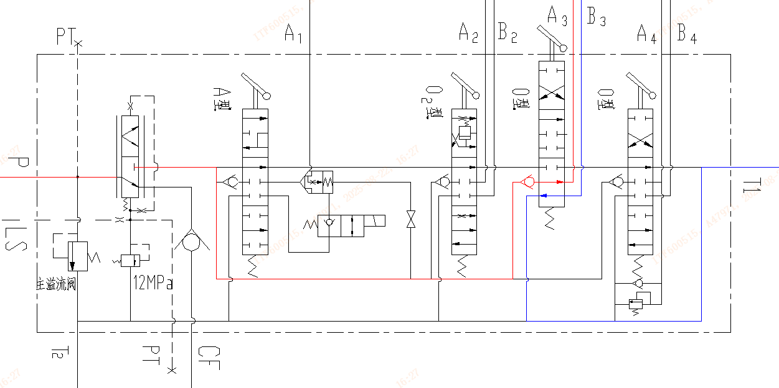
三、工作液压系统Working hydraulic system
3.3.2、多路换向阀（E系列2.0-3.8t机型）Multi-way directional control valve (E Series 2.0-3.8t model)
7.属具油缸移位（如：侧移器）：
操纵操纵杆使主阀位于右移位时主阀内油液的流动方向：工作泵给侧移油缸油缸小腔供油，油缸大腔油液经过换向阀回流到油箱。
Accessory cylinder displacement (e.g., side shifter) :
When the main valve is shifted to the right by operating the control lever, the flow direction of the oil in the main valve is as follows: The working pump supplies oil to the small chamber of the side-shifting cylinder, and the oil in the large chamber of the cylinder flows back to the oil tank through the reversing valve.
高压油
high-pressure oil
回油
Oil return

Slide 30
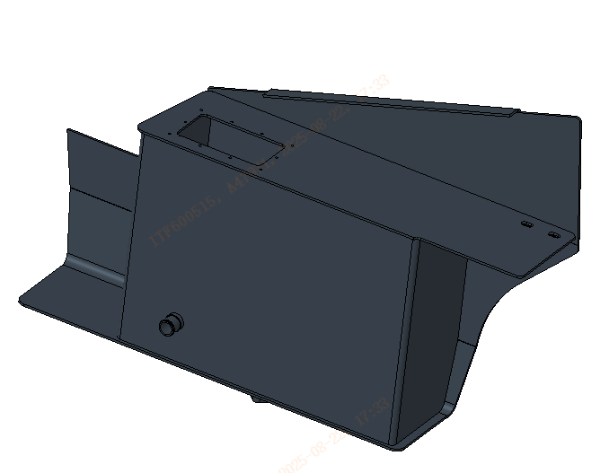
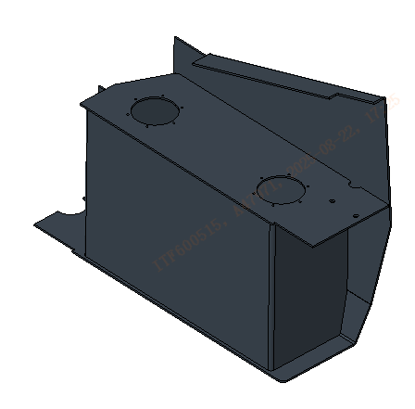
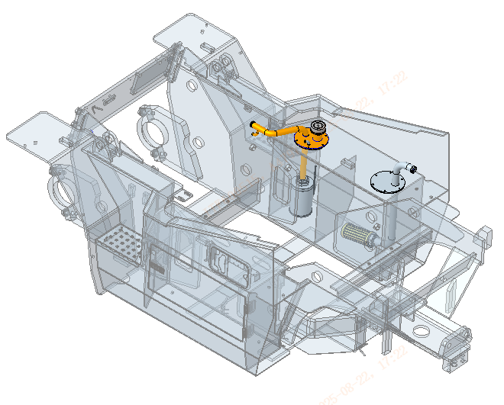
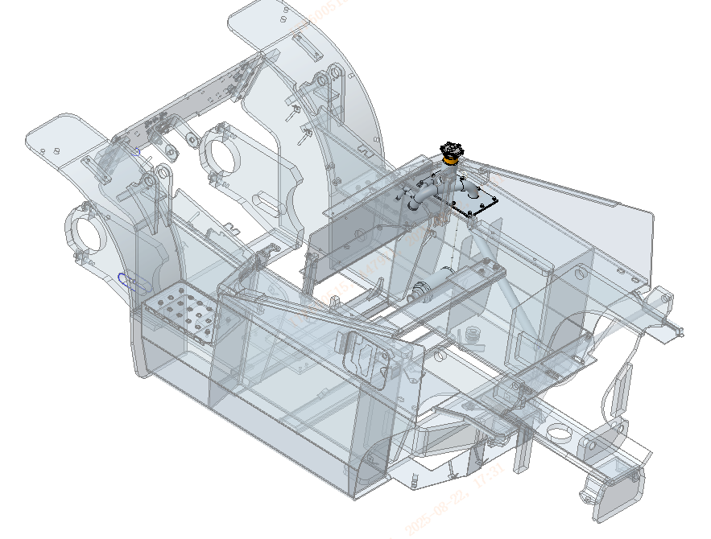
三、工作液压系统Working hydraulic system
3.3.3、液压油箱Hydraulic oil tank
液压油箱为侧置整体式，位于机器右侧中部的车架上，其作用是储存液压系统工作循环和转向所需的液压油，沉淀液压油箱中油液里的污染物，分离油液中的空气，使液压油散热降温。油箱中设置了吸、回油滤，用于过滤液压系统油路中的污染物，以保证液压系统油液的清洁度。下图是液压油箱结构示意图：
The hydraulic oil tank is a side-mounted integral type, located on the frame in the middle of the right side of the machine. Its function is to store the hydraulic oil required for the working cycle and steering of the hydraulic system, settle the contaminants in the oil in the hydraulic oil tank, separate the air in the oil, and dissipate and cool the hydraulic oil. The oil tank is equipped with suction and return oil filters to filter out contaminants in the hydraulic system's oil circuit, ensuring the cleanliness of the hydraulic system's oil. The following figure is a schematic diagram of the hydraulic oil tank structure:
Return oil seat + return oil filter
Oil return seat
Oil suction seat + oil suction filter
Oil-absorbing filter
E Series 4.0-5.0t model
E Series 2.0-3.8t model

Slide 31
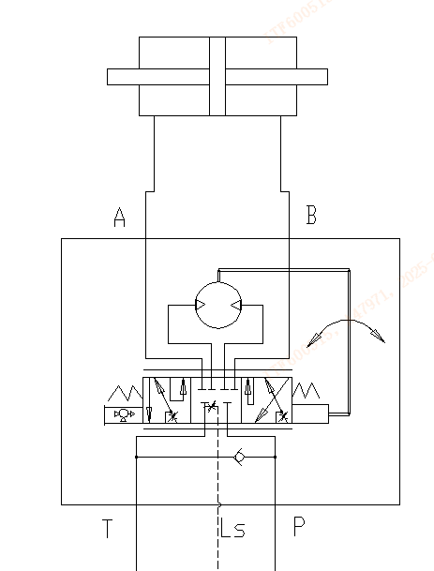
四、转向液压系统Steering hydraulic system
4.1、转向液压系统原理
Principle of steering hydraulic system
1. 转向液压系统从分配阀取油，通过一个大排量转向器控制后桥的转向油缸实现整机转向。
The steering hydraulic system takes oil from the distribution valve and controls the steering cylinder of the rear axle through a large-displacement steering gear to achieve the overall steering of the machine.
2. 转向器带负载敏感口，与优先阀及转向泵配合，实现转向按需供油。
The steering gear is equipped with a load-sensitive port, which, in conjunction with the priority valve and the steering pump, enables on-demand fuel supply for steering
3. 转向器带单向阀，可减轻方向盘打手现象。
The steering gear is equipped with a check valve, which can reduce the jolt of the steering wheel.
Steering cylinder
Load-sensitive steering gear

Slide 32
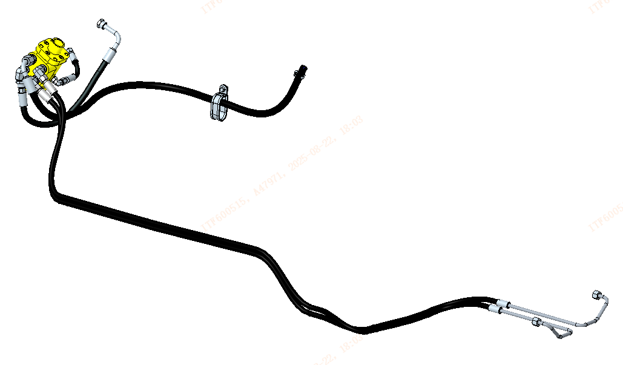
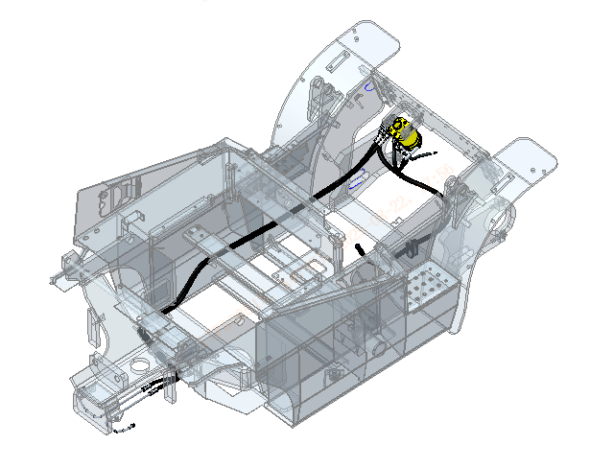
四、转向液压系统Steering hydraulic system
4.2、转向液压系统布局（E系列2.0-3.8t机型）
Steering Hydraulic System Layout (E Series 2.0-3.8t Models)
The P port of the steering gear is connected to the PF port of the multi-way valve
The T port of the steering gear is connected to the return oil cover plate
The LS port of the steering gear is connected to the LS port of the multi-way valve
Connect port A of the steering gear to port R of the steering axle
Connect port B of the steering gear to port L of the steering axle
Notes:
增加一页PPT，0627：
1.电源总开关
2.电锁

Slide 33
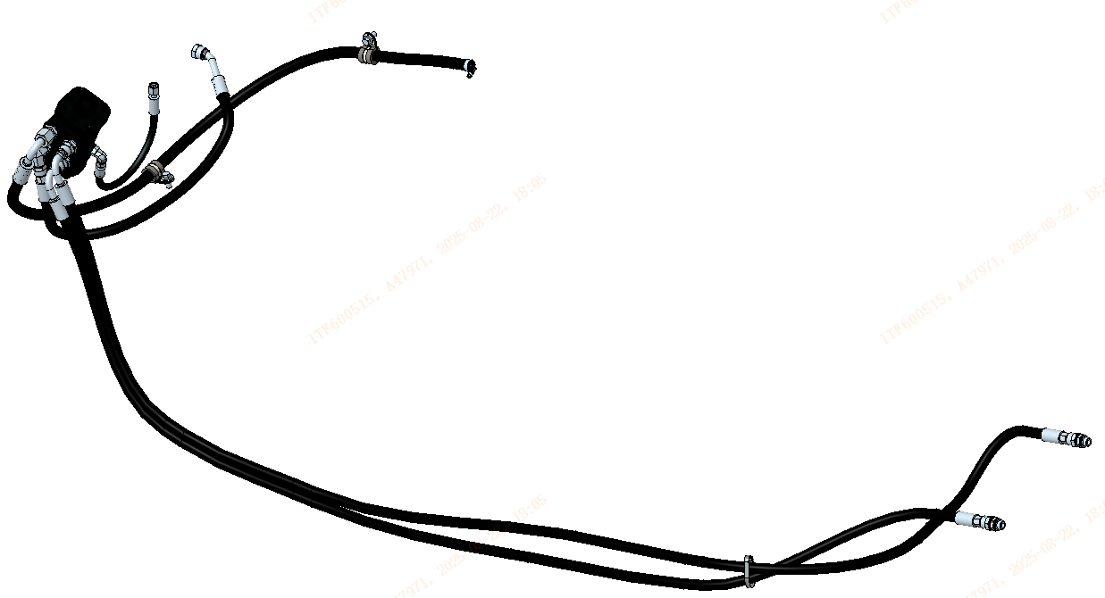
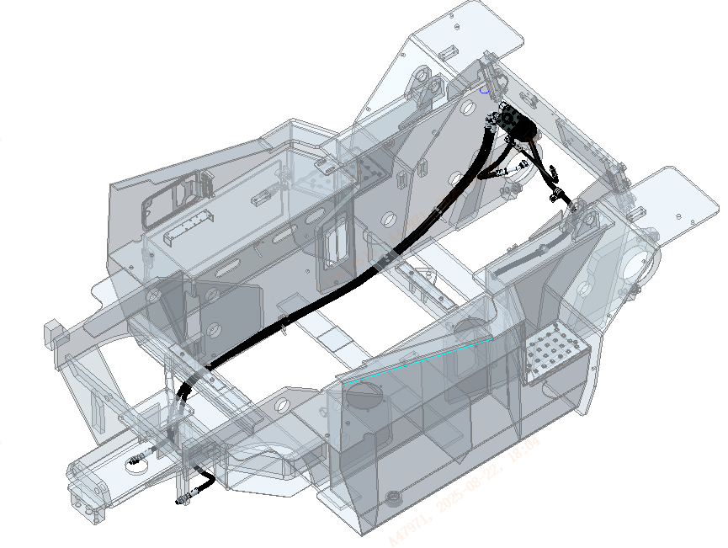
四、转向液压系统Steering hydraulic system
4.2、转向液压系统布局（E系列4.0-5.0t机型）
Steering Hydraulic System Layout (E Series 4.0-5.0t Models)
The P port of the steering gear is connected to the PF port of the multi-way valve
The T port of the steering gear is connected to the return oil cover plate
The LS port of the steering gear is connected to the LS port of the multi-way valve
Connect port A of the steering gear to port R of the steering axle
Connect port B of the steering gear to port L of the steering axle
Notes:
增加一页PPT，0627：
1.电源总开关
2.电锁

Slide 34
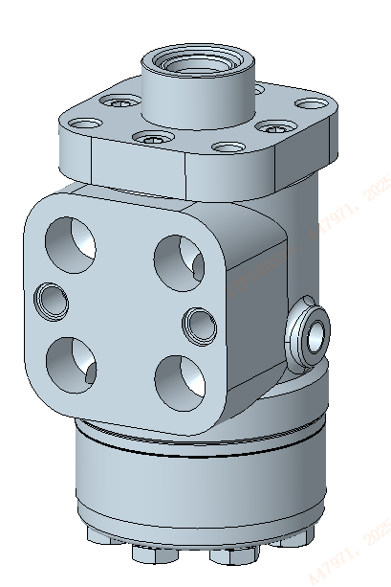
四、转向液压系统Steering hydraulic system
4.3、转向器 Steering gear
转向器位于车架前端地板以下，通过螺栓、支架与车架前连接板连接。工作泵外形图下图：
The steering gear is located below the floor at the front end of the frame and is connected to the front connection plate of the frame through bolts and brackets. The external drawing of the working pump is shown in the following figure
T
Item | Parameter
 | E Series 2.0-3.8t model | E Series 4.0-5.0t model | Notes
Rated displacement | 100ml/r | 200ml/r
Maximum system pressure | 16MPa | 16MPa
Maximum back pressure | 1.6MPa | 1.6MPa
Steering torque | ≤1.4N.m | ≤1.6N.m
Fluid medium | anti-wear hydraulic oil | anti-wear hydraulic oil | L-HM32#
A
LS
P
B
Notes:
增加一页PPT，0627：
1.电源总开关
2.电锁

Slide 35
五、门架液压系统Mast hydraulic system
5.1、门架液压系统原理
Principle of hydraulic system for gantry
门架液压系统包含门架起升、倾斜两部分；其中门架起升回路限速阀直接安装在起升油缸油口，可在没有防爆阀情况下仍实现管路爆破时有效控制门架下降速度。
The gantry hydraulic system consists of two parts: gantry lifting and tilting. Among them, the speed-limiting valve of the mast lifting circuit is directly installed at the oil port of the lifting cylinder, which can effectively control the descent speed of the mast even in the event of pipeline explosion without an explosion-proof valve.
Notes:
增加一页PPT，0627：
1.电源总开关
2.电锁

Slide 36
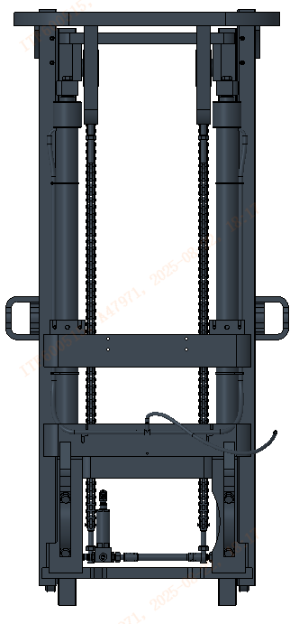
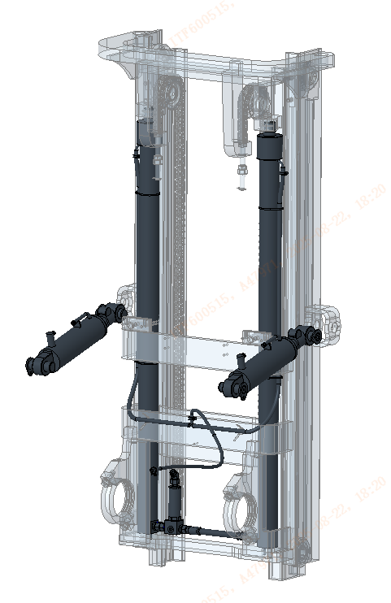
五、门架液压系统Mast hydraulic system
5.2、门架液压系统布局 Layout of hydraulic system for gantry
Lifting cylinder
Connect to port A1 of the multi way valve
Tilt cylinder
Speed Limit Valve
The layout of the gantry in the same series is consistent.
Notes:
修改表达，把右边的线号删除

Slide 37
六、常见故障诊断及处理方法
Common fault diagnosis and handling methods for forklifts
故障现象 Fault phenomenon | 故障原因 cause of failure | 排除方法 exclusion method
工作装置动作无力 或无动作 The working device is unable to move effectively Or no action | 1. 液压油箱油位不足； Insufficient oil level in the hydraulic oil tank; | 1. 检查液压油位是否满足要求； Check if the hydraulic oil level meets the requirements;
 | 2. 工作泵吸油不畅或吸空； Poor oil suction or empty suction of the working pump; | 2. 检查吸油管路是否通畅，检查吸油软管是否有吸憋现象，检查吸油管路是否有外漏，若有，排除相应故障； Check if the oil suction pipeline is unobstructed, inspect the oil suction hose for any suction blockage, and check if there is any leakage in the oil suction pipeline. If so, troubleshoot the corresponding issues;
 | 3. 工作泵内漏严重； Serious internal leakage of the working pump; | 3. 更换新泵； Replace the pump with a new one;
 | 4. 分配阀主安全阀压力调定值过低；或阀芯卡滞； The pressure setting value of the main safety valve of the distribution valve is too low; Or the valve core is stuck; | 4. 更换检查各压力调定值是否满足设计值，并重新调定压力； Replace and check whether the pressure setting values meet the design values, and re adjust the pressure;
 | 5. 分配阀主阀杆卡死； The main valve stem of the distribution valve is stuck; | 5. 清洗阀体内部，检查阀杆复位弹簧的弹簧力； Clean the inside of the valve body and check the spring force of the valve stem reset spring;

Slide 38
六、常见故障诊断及处理方法
Common fault diagnosis and handling methods for forklifts
故障现象 Fault phenomenon | 故障原因 cause of failure | 排除方法 exclusion method
货叉沉降量过大 Excessive settlement of fork | 1. 管接件有外漏； The pipe fittings have external leakage; | 1. 排查管路外漏，更换相应密封元件； Check for external leaks in the pipeline and replace the corresponding sealing components;
 | 2. 油缸密封件损坏，内漏严重； The oil cylinder seal is damaged and there is severe internal leakage; | 2. 排查油缸内泄漏，更换相应密封元件； Check for leaks inside the oil cylinder and replace the corresponding sealing components;
 | 3. 分配阀主阀杆磨损，内泄漏严重； The main valve stem of the distribution valve is worn and there is severe internal leakage; | 3. 检测分配阀内泄漏量是否满足设计值，若不符，更换阀杆； Check whether the leakage inside the distribution valve meets the design value. If not, replace the valve stem;
 | 4. 分配阀主阀杆卡滞，无法复位； The main valve stem of the distribution valve is stuck and cannot be reset; | 4. 清洗分配阀的阀体内部，检查阀杆复位弹簧的弹簧力； Clean the inside of the distribution valve body and check the spring force of the valve stem reset spring;
泵输出流量不足 Insufficient pump output flow | 1. 油泵磨损，泄露量超标； The oil pump is worn and the leakage exceeds the standard; | 1. 拆解检查油泵磨损情况； Disassemble and inspect the wear of the oil pump;
 | 2. 软管变形或堵塞，导致吸油不畅； The hose is deformed or blocked, resulting in poor oil absorption; | 2. 检查泵吸油软管是否变形，导致吸油不畅； Check if the pump suction hose is deformed, causing poor suction;
 | 3. 泵电机转速下降； The engine speed decreases; | 3. 检查泵电机转速； Check the pump motor speed;

Slide 39
六、常见故障诊断及处理方法
Common fault diagnosis and handling methods for forklifts
故障现象 Fault phenomenon | 故障原因 cause of failure | 排除方法 exclusion method
泵吸不进油或吸油不畅 Pump cannot suck in oil or suction is not smooth | 1.吸油滤油器过流面积小或被异物堵塞 The oil suction filter has a small flow area or is blocked by foreign objects | 1.更换合适过流面积的滤油器或清洗被堵塞的滤油器 Replace the oil filter with a suitable flow area or clean the clogged oil filter
 | 2.油箱液位过低 The fuel tank level is too low | 2.油箱按规定注满液压油 Fill the oil tank with hydraulic oil according to regulations
 | 3.油温太低,油液粘度太高 The oil temperature is too low and the viscosity of the oil is too high | 3.按季节换合适油液或加热油液 Change the appropriate oil or heat the oil according to the season
 | 4.油泵的油封损坏,吸入空气 The oil seal of the oil pump is damaged and air is sucked in | 4.更换新油封 Replace the oil seal with a new one
 | 5.油泵旋向不对或转速过高 The oil pump rotates in the wrong direction or the speed is too high | 5.改变油泵旋向,使转速到规定值 Change the rotation direction of the oil pump to reach the specified speed
 | 6.吸油侧漏气 Leakage on the suction side | 6.检查吸油部分及其密封,更换失效密封件 Check the oil suction part and its seal, and replace the failed seal

Slide 40
六、常见故障诊断及处理方法
Common fault diagnosis and handling methods for forklifts
故障现象 Fault phenomenon | 故障原因 cause of failure | 排除方法 exclusion method
阀杆不能复位 The valve stem cannot be reset | 1.操纵机构受卡不灵活 The control mechanism is not flexible due to jamming | 1.检查操纵拉杆 Check the control lever
 | 2.阀杆被脏物挤住 The valve stem is squeezed by dirt | 2.清洗阀、油箱及管路 Clean valves, fuel tanks, and pipelines
 | 3.回位弹簧变形或断裂 The return spring is deformed or broken | 3.拆开后盖检查,更换弹簧 Open the back cover for inspection and replace the spring
 | 4.外力造成阀杆变形 Valve stem deformation caused by external force | 4.重新配阀杆或更换阀分总成 Reinstall the valve stem or replace the valve sub assembly
 | 5.安装面不平,阀体变形造成卡阀 Uneven installation surface and valve body deformation causing valve jamming | 5.调整安装平面，注意拧紧螺栓时的力距 Adjust the installation plane and pay attention to the torque when tightening the bolts

Slide 41
六、常见故障诊断及处理方法
Common fault diagnosis and handling methods for forklifts
故障现象 Fault phenomenon | 故障原因 cause of failure | 排除方法 exclusion method
前倾无自锁或超标 The mast tilts forward without self-locking or exceeds the standard | 1.油液不清洁,使前倾控制小阀芯卡住 Unclean oil causes the small valve core of the forward tilt control to get stuck | 1.清洗阀、油箱、管路；更换倾斜阀杆或平衡阀等 Clean valves, fuel tanks, and pipelines; Replace the inclined valve stem or balance valve, etc
 | 2.接错油口 Connect the wrong oil port | 2.把接错油口倒换过来 Clean valves, fuel tanks, and pipelines; Replace the inclined valve stem or balance valve, etc
溢流阀有振动和噪声 The relief valve has vibration and noise | 1.液压系统中有空气 There is air in the hydraulic system | 1.检查液压系统有空气的原因 Check the cause of air in the hydraulic system
 | 2.油泵吸入空气 The oil pump sucks in ai | 2.检查油泵吸油测 Check the oil pump suction measurement
 | 3.吸油管路阻力过大或油泵吸油侧负压过大 Excessive resistance in the oil suction pipeline or excessive negative pressure on the suction side of the oil pump | 3.检查发生负压过大的原因 Check the cause of excessive negative pressure
 | 4.吸油滤油器堵塞 Blockage of oil suction filter | 4.清洗滤油器,过滤油液 Clean the oil filter and filter the oil
 | 5.溢流阀有一个压力点振动并有噪声 The overflow valve has a pressure point that vibrates and produces noise | 5.调溢流阀,稍稍调高或调低压力表1~2个刻度格 Adjust the overflow valve and slightly raise or lower the pressure gauge by 1-2 scale marks

Slide 42
六、常见故障诊断及处理方法
Common fault diagnosis and handling methods for forklifts
故障现象 Fault phenomenon | 故障原因 cause of failure | 排除方法 exclusion method
快速转向时沉，慢转时轻 Heavy when turning quickly, light when turning slowly | 供油不足 Insufficient fuel supply | 检查油泵的工作是否正常，分流是否正常。若怠速，请检查发动机怠速是否过低。 Check if the oil pump is working properly and if the flow distribution is normal. If idling, please check if the engine idle is too low.
转向沉重 Heavy steering | 1.油液粘度太大，吸油滤清堵塞 The viscosity of the oil is too high, and the oil suction filter is clogged | 1. 规定加注相应标号的液压油和油量。若吸油滤清器堵塞则清洗或更换滤清器。 It is required to add hydraulic oil of the corresponding grade and oil quantity. If the oil suction filter is clogged, clean or replace the filter.
 | 2.油泵磨损过大，容积效率降低。转向供油量不足 Excessive wear of the oil pump leads to a decrease in volumetric efficiency. Insufficient steering fuel supply | 2. 检查泵的磨损，更换新泵；检查泵电机转速是否过低。 Check the wear of the pump and replace it with a new one; Check if the pump motor speed is too low.
 | 3.单向阀的钢球与阀座之间密封不严或者钢球掉落，导致动力转向时，进出油口相连 The sealing between the steel ball and the valve seat of the one-way valve is not tight or the steel ball falls off, resulting in the connection of the inlet and outlet ports during power steering | 3.更换单向阀 Replace the one-way valve
 | 4.转向溢流阀开启过早。溢流阀弹簧断裂或者阀芯被卡 The steering overflow valve opens too early. The overflow valve spring is broken or the valve core is stuck | 4. 清洗或更换溢流阀 Clean or replace the overflow valve

